Slide 1

Sample Superstore Sales Analysis Dashboard Presentation
John Matthew F. Castro

Slide 2
Presentation Overview
This presentation used the ‘Sample Superstore’ dataset for a dashboard analysis project. You can access this raw csv file through this link: https://drive.google.com/file/d/1hf_6irGfDH0JjWEXjzC1sny1NEegUQB4/view?usp=share_link

Slide 3
Dashboard Overview

Slide 4
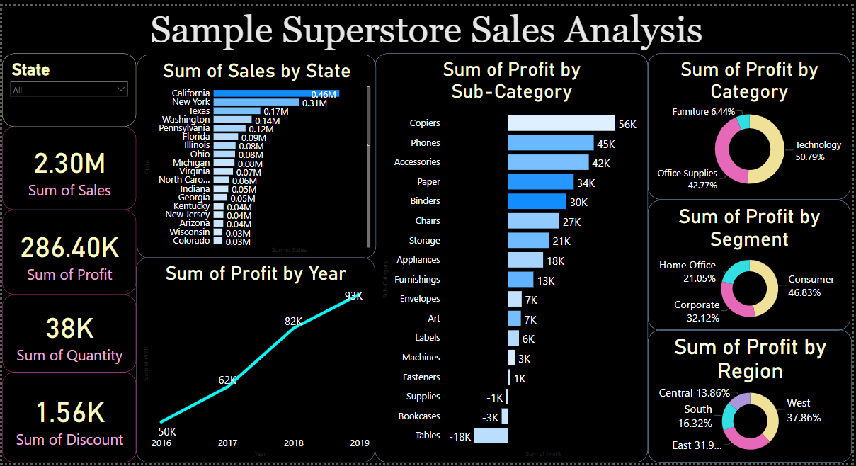
Here is an overview of the dashboard. As the title suggests, we are to discuss the sales analysis of Sample Superstore for the years 2016-2019. Below it are eleven panels which we will tackle as we go along the presentation.

Slide 5
You will be guided accordingly throughout the presentation. Proceed by clicking [SPACE]

Slide 6
Sales Trend Analysis

Slide 7

CONTINUE [SPACE]

Slide 8
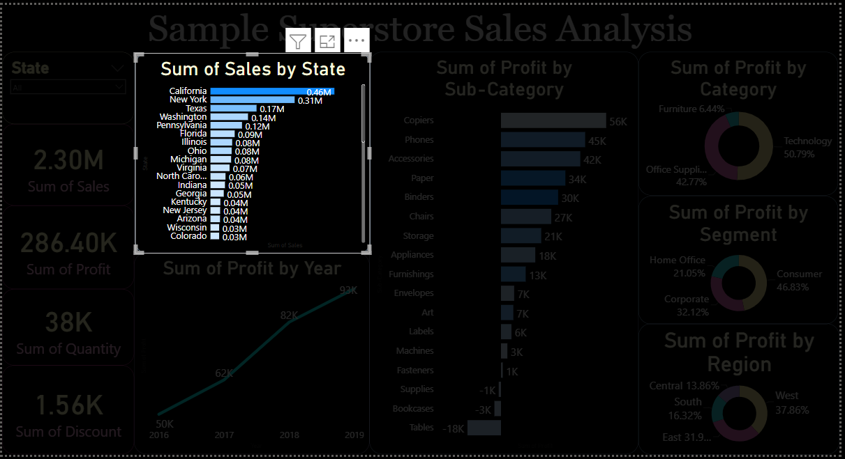
At a glance, we can see the top states that got the most sales. California had the most sales with 0.46M, followed by New York with 0.31M, and at third is Texas with 0.17M.
The darkness of the bar indicate the count of items sold in that state. Rightfully so we see that the states that had the most sales also sold the most quantity of items sold.

Slide 9
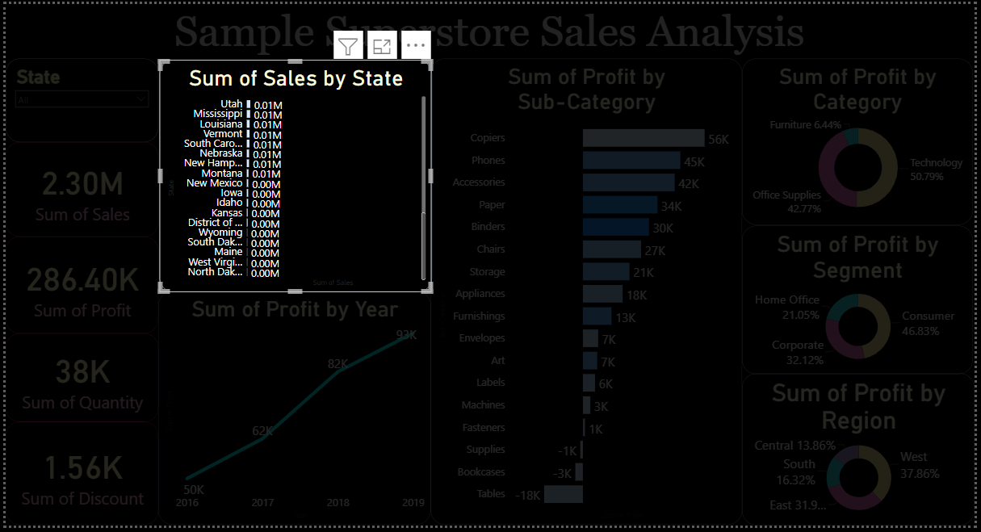
As we scroll down the panel, we can see the states that performed poorest in terms of sales.
The bottom states are comprised of North Dakota, West Virginia, Maine, South Dakota, Wyoming, and District of Columbia.

Slide 10
Profit Trend Analysis

Slide 11
CONTINUE [SPACE]

Slide 12
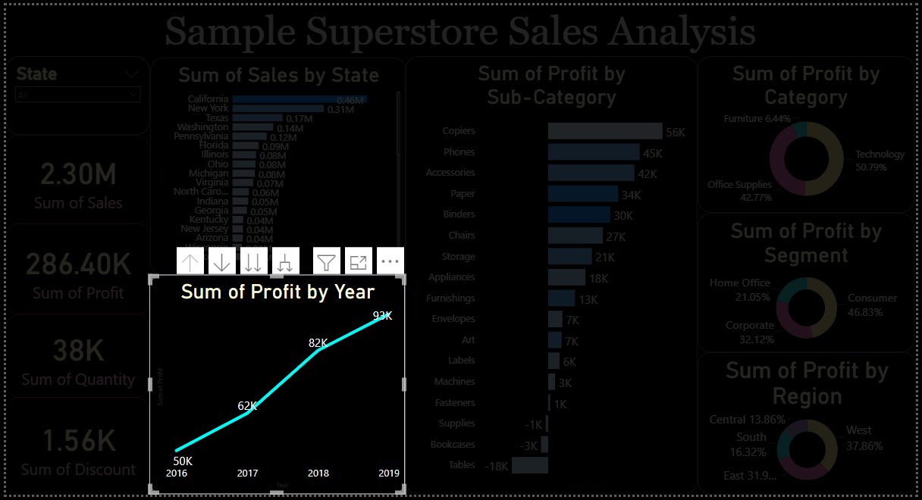
Profits consistently increased over the period from 2016-2019. Each year the company profited more by 12K, 20K, and 11K respectively.
This shows that the company is consistently improving its profits.

Slide 13
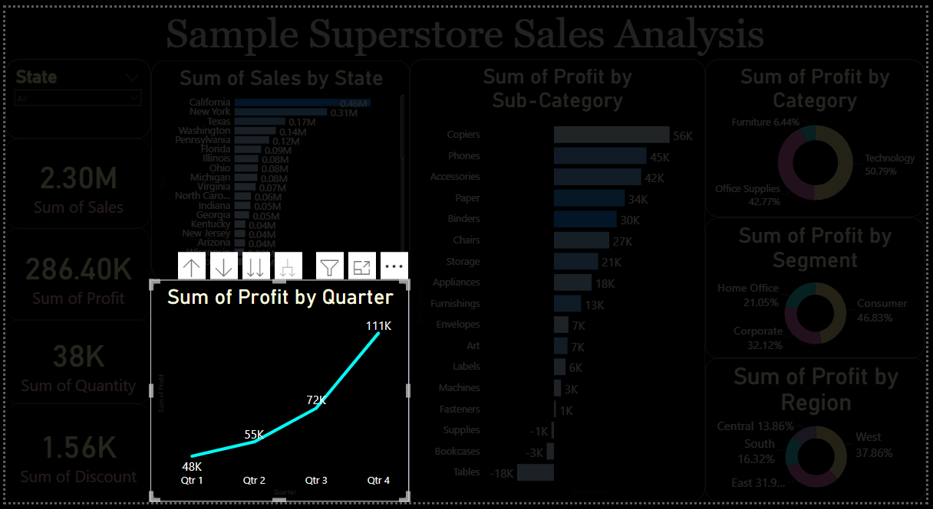
Profit by quarter also show that Q4 gained the most profits for the company.

Slide 14
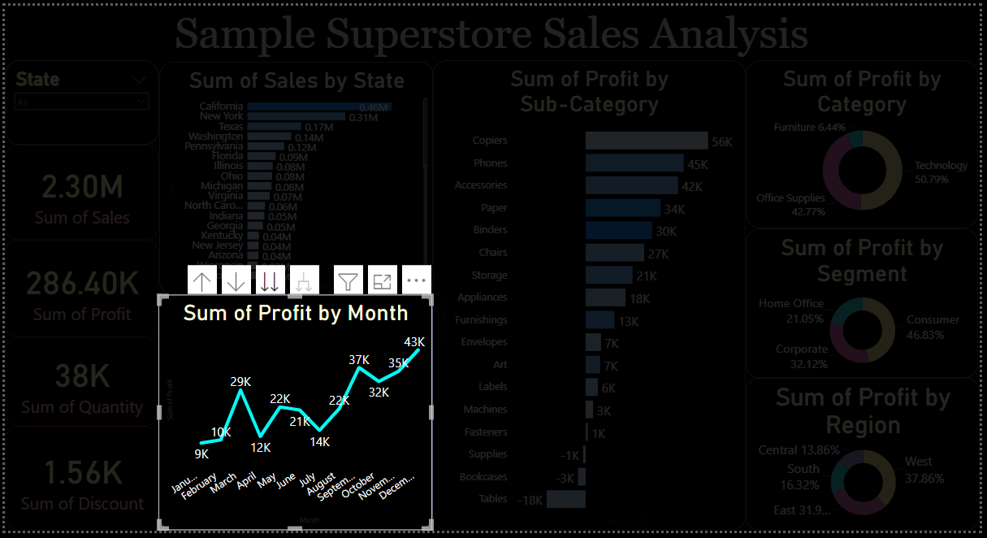
December is when profit peaks for the company.
This could be because more people have greater reason to purchase the items as well as in greater quantities.
There also seem to be a steep decline in profit come January and summer season. This trend suggests that company can improve on this and aim increasing profit in these periods.

Slide 15
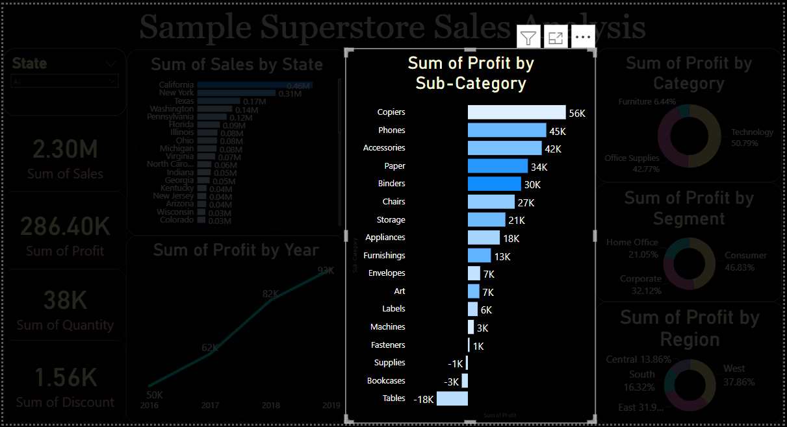
This panel shows sum of profit by sub category.
Copiers, followed by phones and accessories, are the most profitable.

Slide 16
On the other hand, the least profitable products were Tables, Bookcases, and Supplies. All of which had negative profit for the company.

Slide 17
The hue darkness of the bars indicate the greater quantity sold per sub-category.
It seems that Paper and Binders were the most saleable quantity-wise, albeit placing 4th and 5th in the profit hierarchy respectively.

Slide 18
Our findings indicate that it would be smart to stock more supplies of Copiers as they are the most profitable.
Inversely, the company can stock less Tables and the other less profitable products based on this chart.

Slide 19
We will now look into the rightmost panels concerning the profit by category, segment, and region.

Slide 20

CONTINUE [SPACE]
The Technology category is the most profitable with 50.79% of profit share. Office supplies had 42.77% and Furniture performed dismally with only 6.44%

Slide 21
CONTINUE [SPACE]
Consumer items are the most profitable segment with 46.83% followed by Corporate with 32.12% and lastly by Home Office with 21.05%.

Slide 22
CONTINUE [SPACE]
The West region has been the best market with 37.86% of profit share followed by the East (31.9%), South(16.32%), and lastly by Central Region (13.86%).

Slide 23
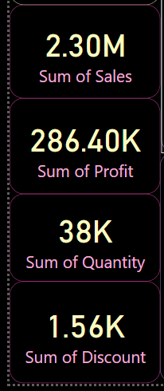
CONTINUE [SPACE]
The four side panel cards here are for quick overview of pertinent information such as Sales, Profit, Quantity, and Discount regarding selected fields for the stakeholder . Try clicking on select fields in the dashboard to see effect.

Slide 24
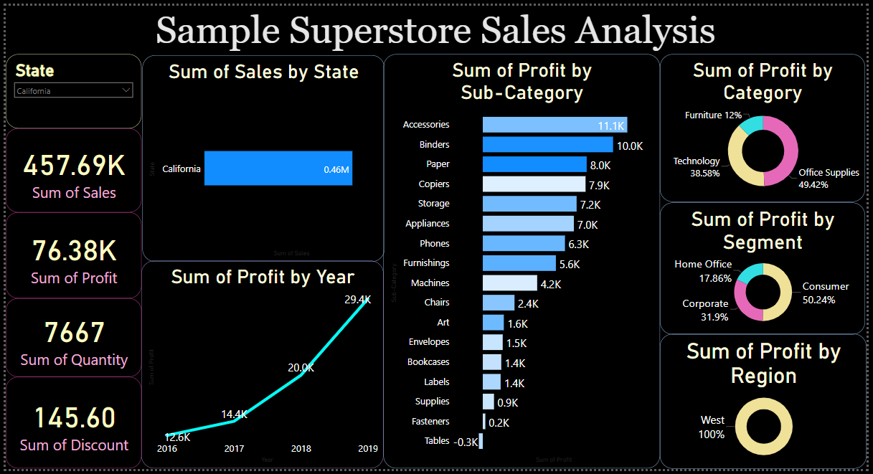
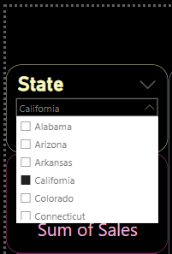
CONTINUE [SPACE]
This panel has a drop down menu showing the states arranged in alphabetical order to serve as an option for the stakeholder to manually select the state he/she is concerned about.
Notice that we selected California and the other panels have adjusted to only show information about this state.

Slide 25
CONTINUE [SPACE]

Slide 26
This is the end of the dashboard presentation. You may refer to the Power BI file related to this presentation for better interactivity.
Thank you.
You can raise questions and inquiries to my email:
jmblitz95@gmail.com

